Slide 1
TB ECHO
Key Principles of Home Sputum Induction
Ann Lund, BSN, RN
Whatcom County Public Health

Slide 2
Conflict of Interest Disclosure Statement
Neither I, nor my spouse/partner have/had financial or other relationships with ANY commercial interest organizations within the past 12 months.

Slide 3
Learning Objectives
Describe the efficacy and yield of induced sputum specimens compared to other collection methods.
Identify pre-procedure assessments necessary to ensure safe sputum induction
List key teaching points for effective sputum coaching
Identify infection control measures necessary when inducing sputum in home setting
Describe set-up & cleaning procedures for portable nebulizer as well as supplies recommended to have on hand

Slide 4
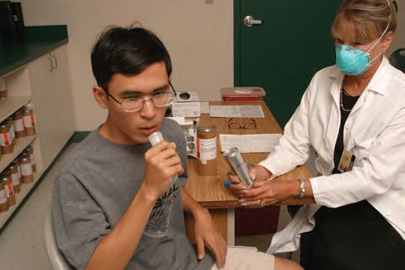
Efficacy of Induced Sputum – Impressive findings published in 2016 ATS/IDSA/CDC Clinical Practice Guidelines: Diagnosis of TB
Question 10: “Should sputum induction or flexible bronchoscopic sampling be the initial respiratory sampling method for adults with suspected pulmonary TB who are unable to expectorate sputum?”
Evidence “We identified 6 studies [172–177] that compared the diagnostic yield of induced sputum with the yield of specimens obtained by flexible bronchoscopy . . . five of the 6 studies demonstrated a higher yield from induced sputum than bronchoscopy, with the remaining study [176] demonstrating a similar yield. The diagnostic yield of induced sputum increases with multiple specimens, with detection rates by AFB smear microscopy of 91%–98% and mycobacterial culture of 99%–100% reported when 3 or more specimens are obtained [178].”
“Induced sputum has equal or greater diagnostic yield than bronchoscopic sampling, has fewer risks, and is less expensive.”
Notes:
“Confidence in the accuracy of the study results is low because there was a risk of bias and indirectness. Regarding risk of bias, most of the studies did not report whether or not consecutive patients were enrolled. There also appeared to be indirectness of the intervention because the studies varied in the number of specimens collected (from 1 to 3 per patient), the concentrations of hypertonic saline, the type of nebulizers, and the culture techniques.”
“Two cost-analysis studies favored sputum induction over bronchoscopy [172, 174]. In the first study, direct costs for bronchoscopy measured in Canadian dollars were $187.60, compared with $22.22 for sputum induction [172]. In the second study, induced sputum was about one-third the cost of flexible bronchoscopy, and the most cost-effective strategy was 3 induced sputa without bronchoscopy [174].”

Slide 5
How Does Induction Increase Sputum Production?
“The water content in the airway originates from the blood flow surrounding the airway, and diffuses into the lumen through an osmotic pressure that is mainly determined by sodium and chloride ion concentration. Salt delivered by nebulization increases the osmotic pressure in the airways and draws more water into the lumen. As a consequence, mucins in the airways are diluted, facilitating sputum expectoration. In addition to its dilutional effects, hypertonic saline also has a protussive effect by stimulating cough reflex, which is believed to facilitate sputum expectoration.” Usefulness of Sputum Induction with Hypertonic Saline Tuberculosis & Respiratory Diseases 2014, 76: 163-168
CDC Core Curriculum – Sputum Induction “For patients unable to cough up sputum, deep sputum-producing coughing may be induced by inhalation of an aerosol of warm, sterile, hypertonic saline (3%– 5%).”
NHS Nottingham University Hospitals Induced Sputum Guidelines for Practice
https://www.nuh.nhs.uk/download.cfm?doc=docm93jijm4n672
“There is no acknowledged ideal concentration of NaCl for an induced sputum, varying from 3-10% (Bell et al, 2004). NUH uses 7% as a standard because it is readily available from pharmacy and has caused less cancellations.”
Notes:
Variation in saline concentration for Induction – CDC 3-5%, WCHD 7%, Chelan Douglas 10%

Slide 6
Induced Sputum Procedure National Jewish
Patients with reactive airways, asthma, COPD or emphysema should be pretreated with fast acting bronchodilator – Albuterol or levalbuterol.
Patients taking Advair, Symicort, Dulera, or Spiriva may not need pre-treatment with inhaled fast acting bronchodilator.
Hypertonic saline options are 3%, 5%, 7% and 10%. Normal saline (0.9%) is generally insufficient to produce sputum specimen.
Hypertonic saline irritates the airways stimulating secretion of thin, watery mucous. Process may take 5 to more than 20 min depending on patient and concentration of saline used.
Sputum obtained by induction will be thin and appear watery; by tilting tube and viewing in good light some clear mucous strands or thicker material may be seen suspended within the watery sample.
Sputum Induction For Health Care Providers – National Jewish Health
https://www.nationaljewish.org/treatment-programs/tests-procedures/sputum-induction

Slide 7
Pre-Procedure Patient Assessment
General status of alertness, breathing pattern, pain level, ability to sit/stand/walk & follow directions
Known respiratory conditions – Asthma, COPD, RAD, emphysema. Condition stable/controlled or recent exacerbation?
Current use of Inhalers or other respiratory medications. Albuterol available?
If unsuccessful on prior attempts to collect sputum - ask about coaching and what techniques tried
Recommended Supplies to have on hand: Stethoscope, Pulse oximeter

Slide 8
Inducing Sputum in Various Home Environments
Use ventilated space away from other family members. Close door to other household areas and leave room window open after procedure
Nebulizer does not have to be used in same space patient will cough
Ideal to set up & use nebulizer close to where patient can step outside to cough in open air
If no yard, porch, or balcony available, garage can be used to cough
If elderly or frail or apartment setting, patient can stand by open door or large window to cough. Try to establish cross breeze with outward flow
If no outdoor area available to cough, use bathroom with door closed & fan on. Leave door closed with fan on 15-20 min after use
Find chair to have available for patient if becomes dizzy while coughing
Alternative spaces used for Sputum Induction in recent practice – RN car in parking lot; warehouse/delivery bay of private medical office

Slide 9
Sputum Coaching Essentials
Key Teaching Points for Collecting Home Sputum Samples
Sputum must be coughed up from lungs and cannot be saliva from mouth or mucous from nose/throat
Best time to collect sputum is first morning upon arising. Lung secretions pool in upper airways during night and easiest to cough up soon after arising; harder to bring up later in day due to downward effect of gravity on lung secretions.
If recently eaten or any food debris in mouth, rinse with water and spit out before procedure
Producing sputum requires major effort to cough deeply and forcefully; use abdominal muscles to cough. Coughing is more forceful standing up, have chair available if get dizzy from coughing.
Need to collect at least 1 teaspoon (4-5 ml) of sputum per sample (size of 25₵ or large marble)
Induced sputums will look watery and may be mostly clear; this is ok and does not mean sample is inadequate if not thick or discolored.
OK to collect 2 samples in same day but must be at least 8 hours apart.
Sputum samples must be refrigerated at home if not delivered to lab immediately.
Need to collect a total of 3 samples, with at least one early morning specimen. Remind to 1. Label cup with name, time and date of collection
2. REFRIGERATE sample until delivered to lab.

Slide 10
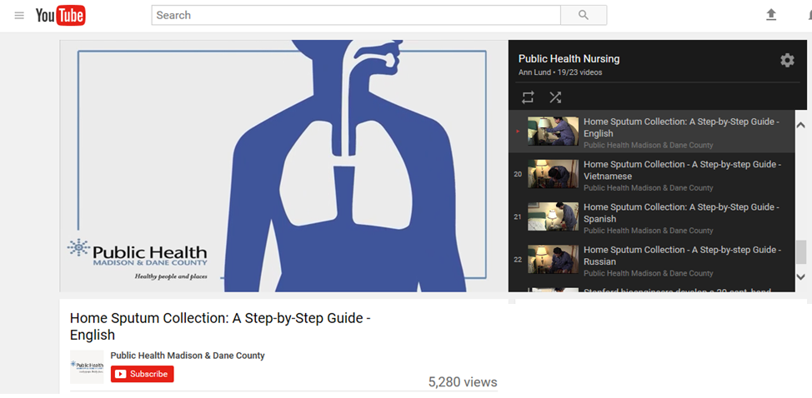
YouTube Step-by-Step Video Guide to Home Sputum Collection
Available in 19 languages, 7 min long
Produced by Public Health Madison & Dane County Wisconsin
To send video link to a cell phone from email, attach link to message and send to 10 digit cell number plus carrier code
Verizon: cell # @vtext.com (i.e. 3603059350@vtext.com)
AT&T: cell # @txt.att.net T-Mobile: cell # @tmomail.net
Sprint: cell # @messangingsprintpcs.com Boost: cell # @myboostmobile.com
https://www.youtube.com/watch?v=rIQDP41Qd8s&list=PLO9RoNDnObhOcYPpeYMTG3BpPHU5-Le6H

Slide 11
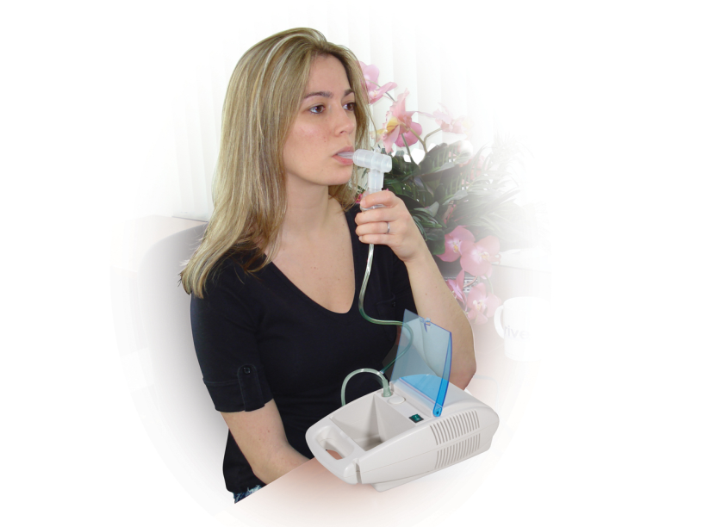
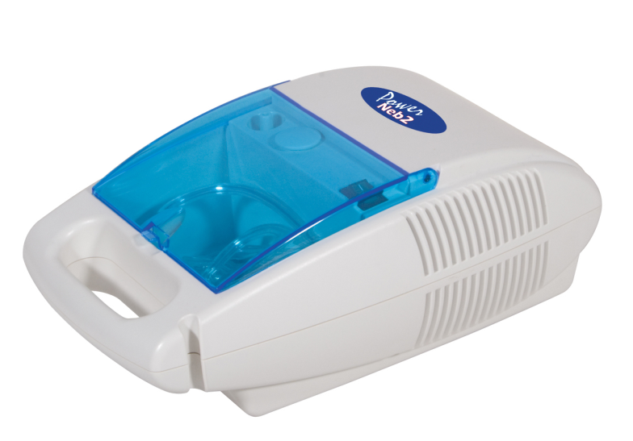
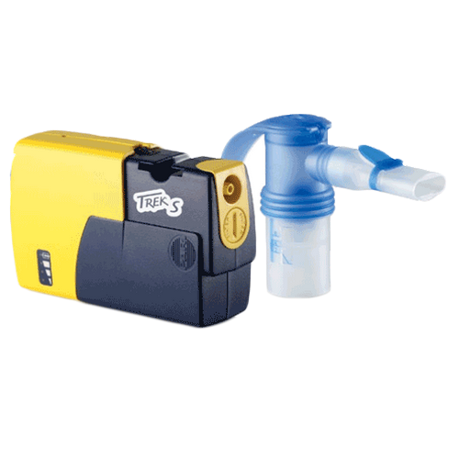
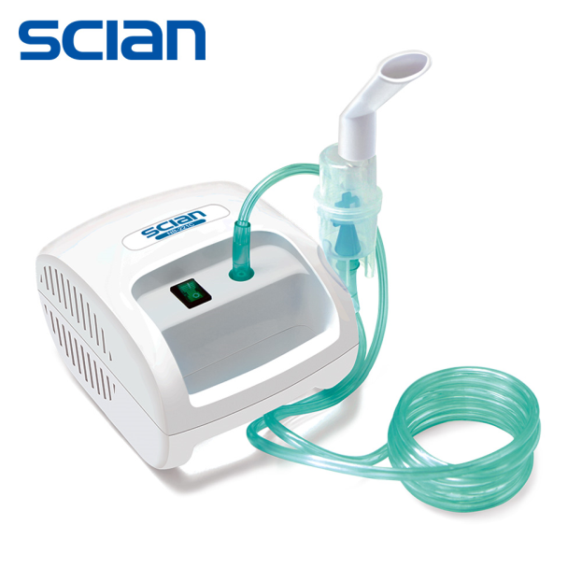
Portable Home Nebulizers
Power Neb II Nebulizer by Drive Mobility
Pari Trek S Compact Nebulizer

Slide 12
Important Procedural Reminders
For patients at risk of bronchospasm, discuss with physician options to dilute saline concentration with sterile normal saline (0.9%). Request physician to also advise on using bronchodilator prior to induction.
Always wear N-95 mask or PAPR respirator when assisting TB patient to collect Induced sputums. No family member should assist with procedure.
Ensure patient does not cough outside in front of fresh air intakes or by open windows or doors of others not exposed.
Clearly label BOTH specimen tube & lab requisition “INDUCED SPUTUM” Watery samples run risk of being discarded by lab
After Induction completed, empty remaining saline in chamber & rinse mouthpiece & tubing kit with sterile distilled water to flush salt crystals. Allow to dry then place in plastic bag if need to collect more samples. Discard after one week.
Clean surface of nebulizer unit with Cavi wipe or other TB rated germicidal. Can also use 1:10 bleach solution.

Slide 13
Demonstration of WCHD Nebulizer and Supplies
.

Slide 14
References
Official American Thoracic Society/Infectious Diseases Society of America/ Centers for Disease Control and Prevention Clinical Practice Guidelines: Diagnosis of Tuberculosis in Adults and Children https://academic.oup.com/cid/article/64/2/e1/2629583
Sputum Induction Simpler, Cheaper, and Safer—But Is It Better? Dick Menzies, M.D., M.Sc. AMERICAN JOURNAL OF RESPIRATORY AND CRITICAL CARE MEDICINE VOL 167 2003 https://www.atsjournals.org/doi/full/10.1164/rccm.2212008#readcube-epdf
Usefulness of sputum induction with hypertonic saline in a real clinical practice for bacteriological yields of active pulmonary tuberculosis. https://www.ncbi.nlm.nih.gov/pmc/articles/PMC4021263/pdf/trd-76-163.pdf Tuberc Respir Dis (Seoul). 2014 Seong GM¹, Lee J¹, Lee JH¹, Kim JH², Kim M¹.
Sputum Induction For Health Care Providers - National Jewish Health https://www.nationaljewish.org/treatment-programs/tests-procedures/sputum-induction
Performing Sputum Induction page 82 Tuberculosis Infection Control Curry International Tuberculosis Center http://www.currytbcenter.ucsf.edu/sites/default/files/ic_book_2011.pdf

