Slide 1
TB Patient Engagement and Telehealth Use of personal EKG monitoring devices in Florida
Sherrie Arnwine Executive Community Health Nursing Director, TB Control Section Florida Department of Health

Slide 2
Why Use Personal EKGs?
New TB regimens with cardiac monitoring recommendations
BPaL
4-Month RPT-MOX-INH-PZA
Obstacles with traditional EKG monitoring
Lack of EKG equipment
Lack of trained staff to perform
and read EKGs
Extended visit times

Slide 3
What Do We Do?
This Photo by Unknown Author is licensed under CC BY-NC-ND

Slide 4
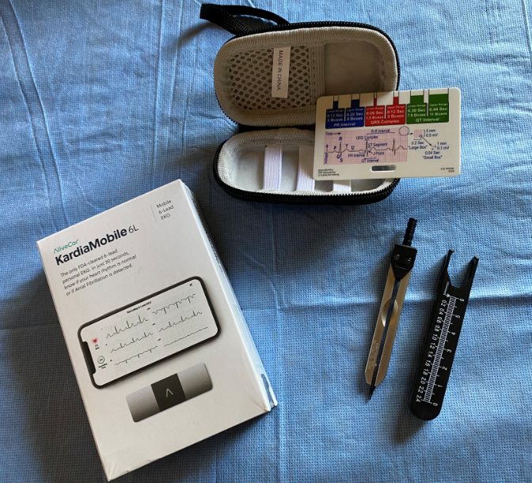
Introducing KardiaMobile 6L
Product by AliveCor
Personal Portable EKG Device
Affordable alternative to traditional EKG
Quick and easy set-up using a smart device
Free account set-up is required
Subscription to service not required
User friendly
Notes:
The only FDA-cleared 6-lead personal EKG

Slide 5
The Unboxed Product

Slide 6
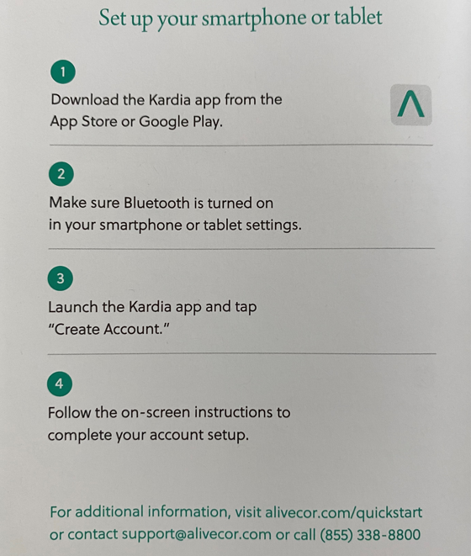
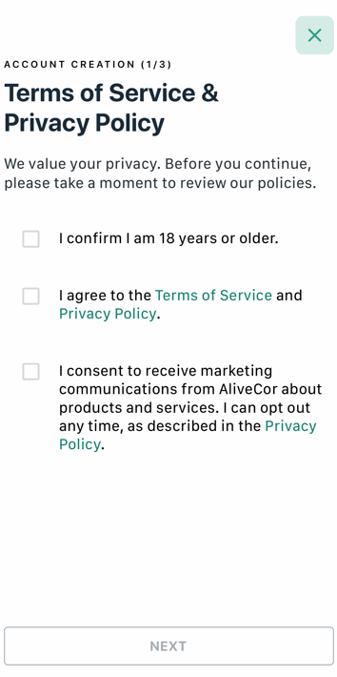
Set-up

Slide 7
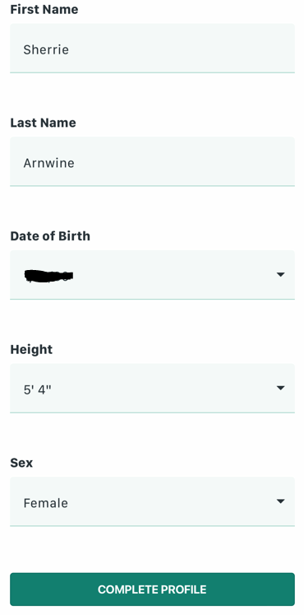
Creating The Patient’s Profile
Create account and profile
Notes:
This Photo by Unknown Author is licensed under CC BY-NC

Slide 8
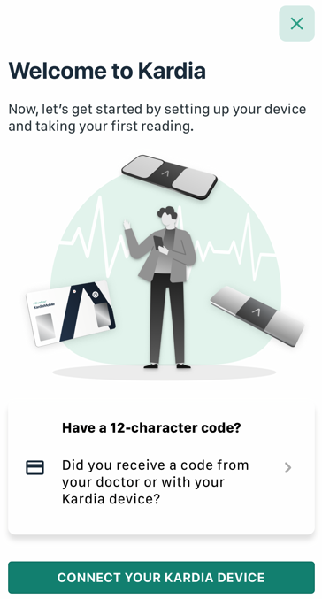
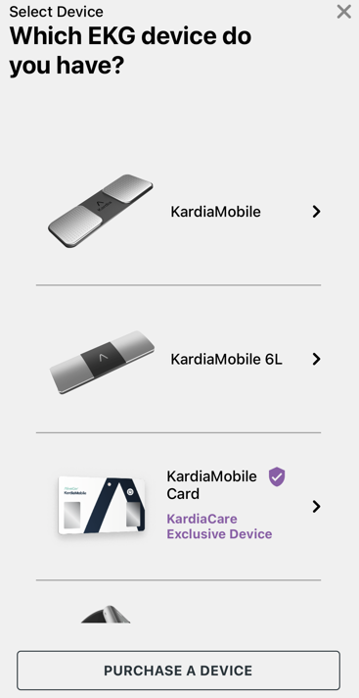
Set-up Options

Slide 9
Step-by-Step On-Screen Tutorial

Slide 10
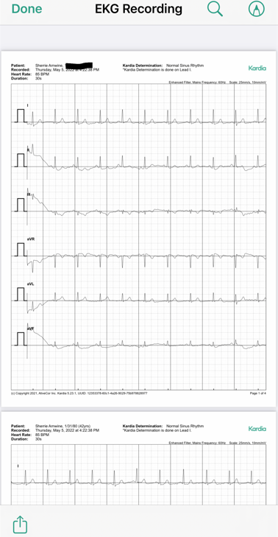
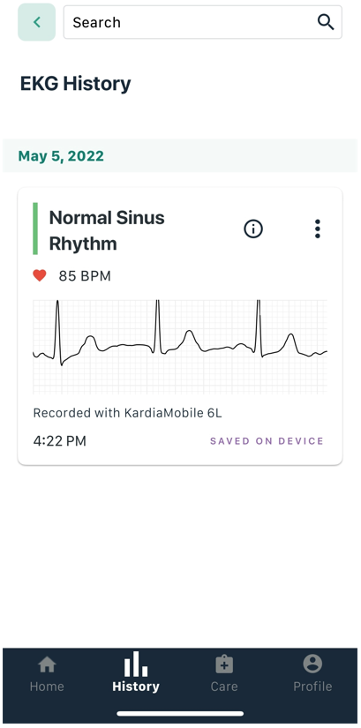
Downloading EKG Recording

Slide 11
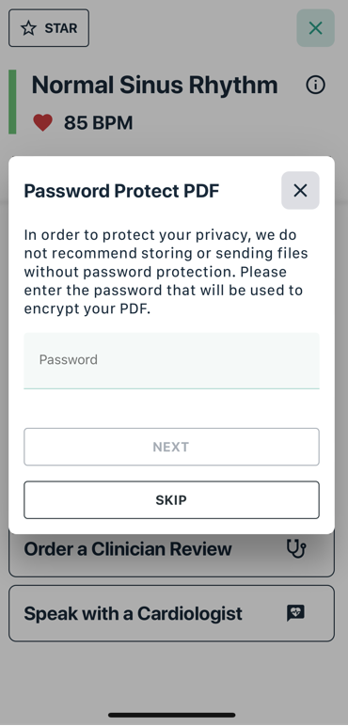
Messaging Options

Slide 12
Encrypted Transmission to Recipient

Slide 13
QT Interval Interpretation Process
The patient sends EKG strip to their TB Nurse Case Manager (TB NCM)
TB NCM then sends it to the to the TB Program’s Medical Director for measurement of the QT interval
The Medical Director then returns the copy of the EKG with the interpretation documented, back to the TB NCM to upload in the client’s electronic health record.
This process is completed at baseline, 2 weeks after the patient starts treatment, and then once monthly while on TB treatment.

Slide 14
Questions?
Sherrie Arnwine, Nursing Director
Bureau of Communicable Diseases
Tuberculosis Control Section
Florida Department of Health
850-491-9147
Sherrie.Arnwine@FLHealth.gov

Slide 15
Thank you!

